Slide 1
FINAL PROJECT TEMPLATE

Slide 2
THREAT SUMMARY
Summary of Situation: Hospital A, B, C got a popup message about all of their files being encrypted and they would have to pay the ransom which in this case is bitcoins. Once the certain bitcoin amount has been paid the key to decrypt the files would be given. There is also a timer where once certain time expires, the ransom increases. This incident occurred after opening an email attachment. Hospital X has not been infected by this incident.
Asset: Personal documents and files (Log Management Files and Patient Records)
Impact: Confidentiality, Availability and Integrity is being impacted here
Threat Actor: It could be both an external threat actor or an internal threat actor. In terms of external threat actor, it could be someone who is attacking for monetary reasons. In terms of an internal threat actor, the user from the technology department could also purposely clicked on the email attachment to infect the organization for financial gains. From the ransomware message, FIN4 is the financial motivated group trying to attack the organization where they target particularly healthcare organization. They don't persistently infect with malware but they do capture important credentials.
Threat Actor Motivation: The person might be holding a grudge against the organization and wants to sabotage their technology for gaining some money. It could also be an unhappy employee(an insider) who also would have the same goal to sabotage the company. It could also be another organization(employee) who wants to steal this organization resources and ideas. The attackers could also be financially motivated (classified as cyber criminals) and wanted some money in return for the credentials they have stolen.
Common Threat Actor Techniques: There is Intentional attack and Unintentional attack. Intentional attack can be classified as Spoofing, Man-in-middle, Password cracking. Unintentional attack can be classified as Human errors such as sharing sensitive details and even clicking unwanted emails.

Slide 3
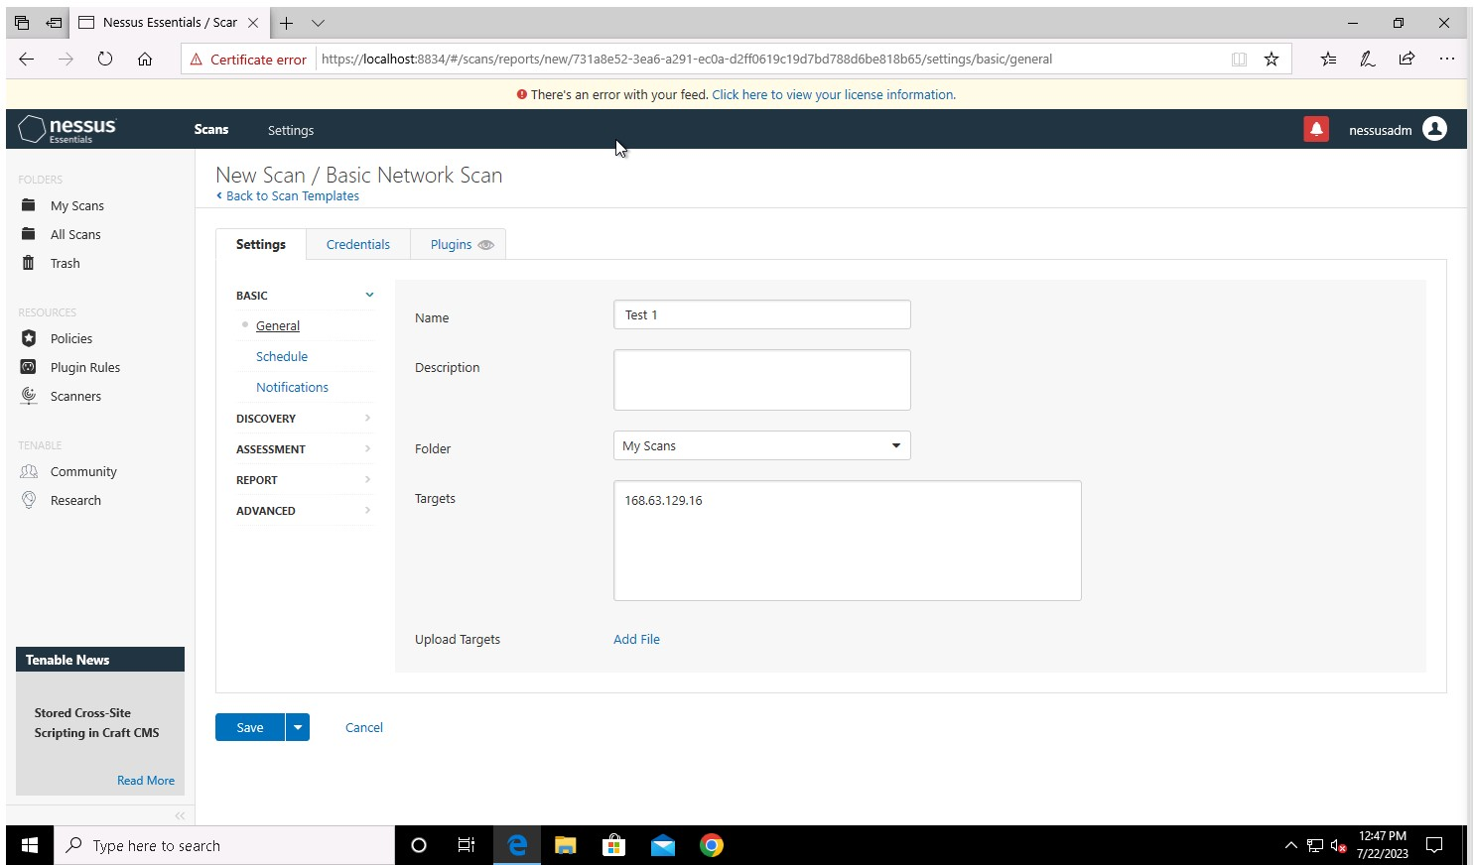
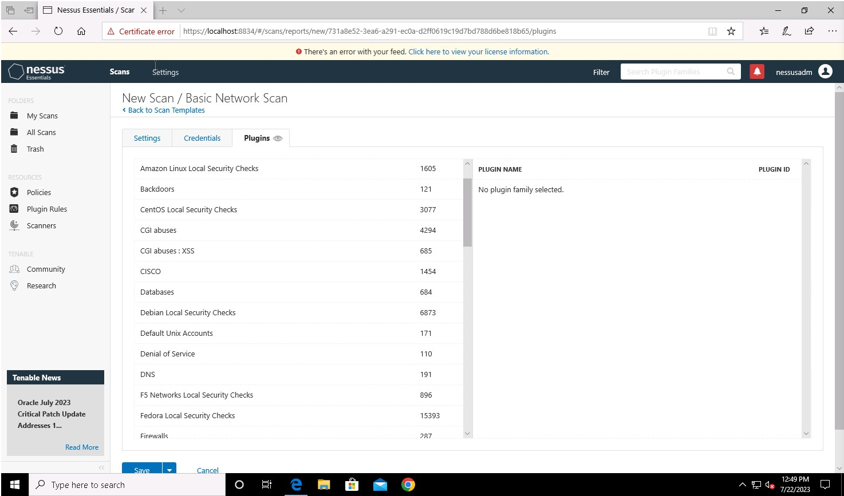
VULNERABILITY SCANNING TARGETS
Summary of scan targets:
Number of devices scanned: 1
Device type: Virtual Machine
Primary purpose of device: A General Purpose Computer(describe what the devices are used for and what kind of data might be on them)
(insert 2 screenshots from scan configuration window – one of the settings tab and one of the plugins tab)

Slide 4
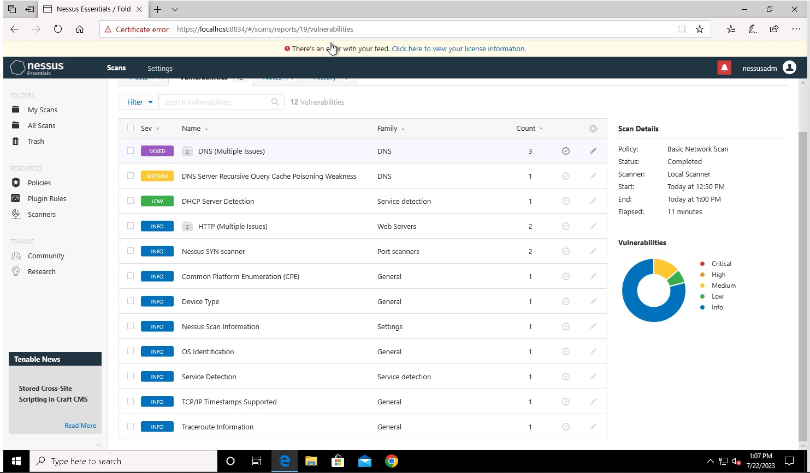
VULNERABILITY SCAN RESULTS
Summary of findings:
Total number of actionable findings: 12
Critical: 0
High: 0
Medium: 2
Low: 1
(insert screenshot from scan results dashboard)

Slide 5
REMEDIATION RECOMMENDATION
Fix within 7 days
Finding | Severity Rating | Recommended Fix
No high or critical vulnerability are there
Fix within 30 days
Fix within 60 days
Finding | Severity Rating | Recommended Fix
DNS Server Spoofed Request amplification DDoS | Medium | Restrict access to your DNS server from public network or reconfigure it to reject such queries
DNS Server Recursive Query Poisoning Weakness | Medium | Restrict recursive queries to the hosts that should use this nameserver
Finding | Severity Rating | Recommended Fix
DHCP Server Detection | Low | Apply filtering to keep this information off the network and remove any options that are not in use

Slide 6
PASSWORD PENETRATION TEST OUTCOME
Methodology: I placed all the hashed password in a text file(polo.txt) and by using the command (shown in next slide) I was able to crack 38 passwords. I used the hashcat command along with -m (hash type) -a (attack mode) then the file with hash password and a dict file for helping decode
Number of passwords tested: 128416
Number of passwords cracked: 38
Evidence of weak passwords: 38
(insert screenshot of cracked passwords and command used to launch attack)
Next Slide
Recommended steps to improve passwords security:
Password must contain alphabets, numbers, characters etc
Password must be changed every 2 to 3 months
Password must be at least 8 characters long
Weak password must not be allowed to be registered and only strong passwords must be allowed
(Summarize best practice recommendations to avoid brute force attacks in the future)

Slide 7
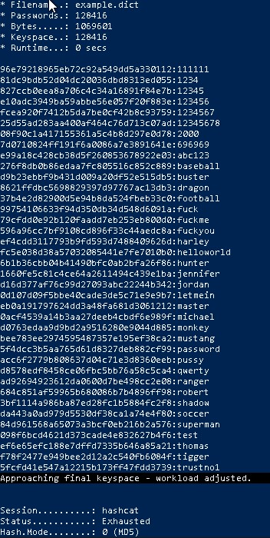
COMMAND AND ITS OUTPUT

Slide 8
INCIDENT RESPONSE PRELIMINARY ASSESSMENT
Summarize ongoing incident:
An email attachment has caused the attack to take over the hospital. The attack encrypted all the personal document and they have demanded us to pay 1 million bitcoin in return for a decryption key. Without these documents, the doctors, nurses and other healthcare workers don't have access to patient information and they are not able to provide any care for the patient. Even the log analysis tool is not accessible.
Document actions or notes from the following steps of the initial incident response checklist
Step 1: Start a meeting with everyone from the cyber department
Step 2: Restore any of the data from cloud or even backup servers
Step 3: Analyze through which email attachment the attack has started
Step 4: Check if the email attachment has been sended to other employee and warn them not to open such attachments (Prevent it from spreading)
Step 5: Don't pay ransom instead try to build up the security around the organization
Step 6: Once the incident has passed, make sure to make regular backup in a secure place where only authorized people have access to it through a password or a key
Step 7: Conduct a meet with the organization and teach them to make sure they are aware of the fundamentals of cybersecurity such as phishing etc
(Add another slide if needed)

Slide 9
INCIDENT RESPONSE RECOMMENDED ACTION
Summarize recommendation to contain, eradicate, and recover:
Source was email attachment, it must be isolated and deleted. Delete the software which showed the pop up messages. Recover all the files from a backup server or cloud. The backing up of the data is very important because the employees were not able to treat the patients in need due to the lack of data which has been encrypted. Every staff must be cyber aware of phishing attacks etc so they must complete basic cyber security awareness program.
Documented actions and notes from the IR checklist
Step 8: Document all the causes and what has occurred in this incident, how it has impacted the organization and the risk level
Step 9: Perform vulnerability scans and even come up with procedure to handle Insider threat and do a malware analysis
Step 10: Work with the HR to analyze the employee if this in fact was an insider attack or it was unintentional
Step 11: Make sure the system is updated and secure (firewall up) and backup are consistently made (which must also be secure)
Step 12: Plan for future incidents such as come up with scenarios and how to defend against those attack with the cybersecurity department
(Add another slide if needed)

